Slide 1




Essential Java Concepts for MapReduce in Big Data Applications
Introduction to implementing MapReduce in Java for Big Data applications. Importance of understanding key Java concepts for MapReduce.
by Kaveti Sai Sumedh

Slide 2
Interfaces and Classes
Mapper and Reducer Interfaces
Task Definition Importance
Understanding the role of interfaces like Mapper and Reducer, and classes like Mapper.Context and Reducer.Context in effectively defining map and reduce tasks within the MapReduce framework. These play a crucial role in the functioning of MapReduce.
Explanation of interfaces like Mapper and Reducer, and classes like Mapper.Context and Reducer.Context. Importance of these interfaces and classes in defining map and reduce tasks within the MapReduce framework.

Slide 3

Generics
1
Definition and Usage in MapReduce
2
Enhanced Code Reusability
Definition of Java generics and their usage in MapReduce frameworks. How generics specify input and output data types for mappers and reducers.
The significant role of generics in enhancing code reusability and ensuring type safety within the MapReduce framework, contributing to reliable and efficient data processing.
3
Ensuring Data Integrity
How generics ensure data integrity within MapReduce applications by specifying input and output data types for mappers and reducers, contributing to error reduction and streamlined processing.

Slide 4



Serialization
Importance in Data Handling
Importance of Java serialization for sending data between mappers and reducers. Understanding efficient serialization and deserialization of complex data types.
Data Transfer Optimization
Role of Java serialization in optimizing data transfer between mappers and reducers, ensuring efficient and streamlined processing within MapReduce applications.

Slide 5

Concurrency and Multithreading
1
Parallel Processing Explanation
Explanation of parallel processing in MapReduce and its reliance on concurrency and multithreading.
2
Efficiency Considerations
Importance of understanding concurrency for efficient execution of MapReduce jobs, ensuring optimal resource utilization and streamlined data processing.
3
Thread Management Insights
Insights into thread management within MapReduce applications, focusing on the significance of concurrency and multithreading for parallel processing and performance enhancement.

Slide 6

File I/O
Data Input Processing
Data Output Management
Overview of reading input data from files and processing it in MapReduce jobs. Also, the significance of file I/O mechanisms in Java for data ingestion and manipulation.
Importance of Java's file I/O mechanisms in writing output data to files in MapReduce jobs, emphasizing efficient output management and data storage optimization.

Slide 7
Collections Framework
1
2
Role in Data Processing
Data Manipulation Efficiency
Role of Java collections such as Lists, Maps, and Sets in processing and manipulating data in MapReduce jobs.
Importance of a strong understanding of Java collections for effective MapReduce implementation, ensuring efficient data manipulation and management.

Slide 8
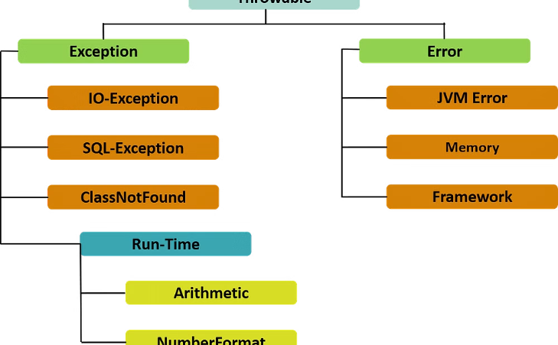
Exception Handling
Crucial Role in Data Safety
Crucial role of exception handling in MapReduce jobs to manage errors during data processing, emphasizing data safety and integrity within MapReduce applications.

Slide 9
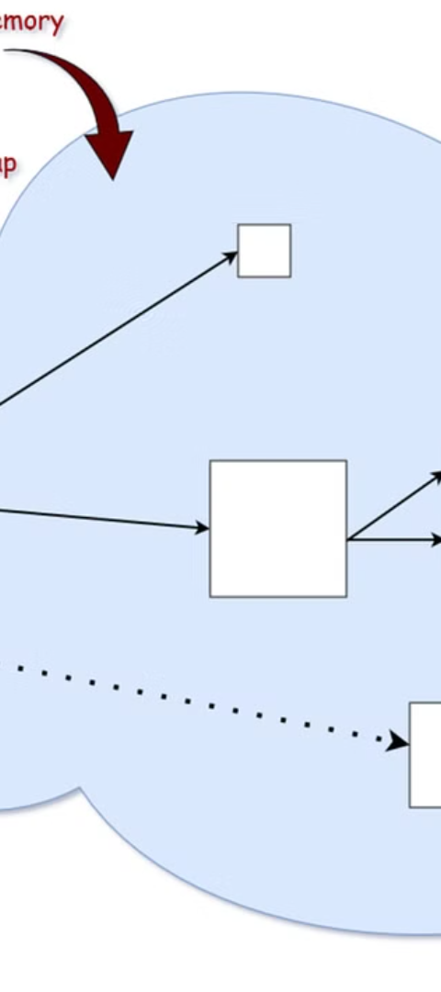
Memory Management
Optimizing Performance
Garbage Collection Strategies
Importance of efficient memory management for optimizing performance in MapReduce, especially with large datasets.
Overview of Java's memory management mechanisms, garbage collection, and memory allocation strategies, focusing on their significance in efficient MapReduce implementation.

Slide 10

Unit Testing
Reliability Assurance
Explanation of the importance of writing unit tests for MapReduce jobs, ensuring correctness and reliability.

